Slide 1
UNIT – I
Testing of Hypothesis
Prepared by
Dr.S.Vanitha
VESRION 1.0

Slide 2
OBJECTIVE
To impart knowledge to use statistical methodology and tools in the engineering problem solving process
Contents in this unit
Large sample test based on Normal distribution for single mean and difference of means-Tests based on t, Chi-square and F distribution for testing means and variances-Contingency table(Test for independency)-Goodness of fit

Slide 3
OUTCOME
The student will be able to
Able to use statistical methodology and tools in the engineering problem solving process

Slide 4
CONTENTS
Introduction to sampling theory
Introduction to testing of hypothesis
Large sample test
test for single mean
test for difference of means
Small sample test
test for single mean
test for difference of means
Test for variance
Test based on Chi-square distribution

Slide 5
SAMPLING THEORY - INTRODUCTION
POPULATION: In a statistical investigation the interest usually lies in the assessment of the general magnitude and the study of variation with respect to one or more characteristics relating to individuals belonging to a group. Group of individuals under study is called population or universe.
SAMPLE: a finite subset of statistical individuals in a population is called the sample.
SAMPLE SIZE: The number of individuals in a sample is called the sample size.
SAMPLING ERROR: The error involved in sampling is called sampling error.

Slide 6
Advantages of sampling
(I) If the population is infinite complete enumeration is not possible.
(II) If the units are destroyed in the course of inspection 100% inspection through possible is not desirable.
(III) Even if the population is finite or the inspection is not destructive, 100% inspection is not taken because of multiple causes like administrative and financial implications, time factor etc.

Slide 7
TYPES OF SAMPLING
PURPOSIVE SAMPLING: The sampling units are selected with purpose in view.
Eg. Standard of living is high in Chennai city ; collect the sample for rich and posh localities
RANDOM SAMPLING: The sample units are selected at random. Each unit in the population has an equal chance of being selected.
STRATIFIED SAMPLING: The entire heterogeneous population is divided into a number of homogenous groups, usually termed as strata, which differ from one another but each of these groups is homogenous within itself. Then units are sampled at random from each of these stratum.

Slide 8
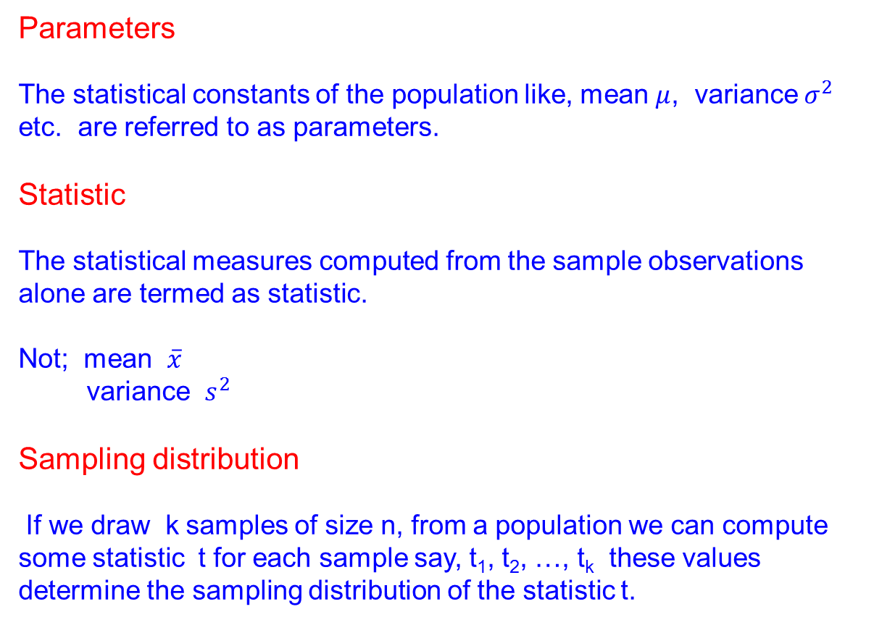
Parameters
The statistical constants of the population like, mean $μ$, variance${ σ}^{2}$ etc. are referred to as parameters.
Statistic
The statistical measures computed from the sample observations alone are termed as statistic.
Not; mean $\overline{x}$
variance $s^{2}$
Sampling distribution
If we draw k samples of size n, from a population we can compute some statistic t for each sample say, t₁, t₂, …, t_{k} these values determine the sampling distribution of the statistic t.

Slide 9
Standard error
The standard deviation of the sampling distribution of a particular statistic is called the standard error of that statistic.
The decision maker, calculates a statistic for a sample and from that statistic would infer something about the population parameter i.e., he estimates the population based on the sample.

Slide 10
Two types of problems in sampling theory
Estimation: If we calculate an approximate value of the population parameter based on the sample values, then it is estimation
Testing of hypothesis: Some characteristic or feature of the population may be available to us ; and we would like to know whether the information is tenable (or acceptable) based on the random sample drawn from the population ; and if it can be accepted with what degree of confidence, it can be accepted. This type of problem is testing of hypothesis.

Slide 11
Tests of significance / test of hypothesis
To decide on the basis of the sample results if:
The deviation between the observed sample statistic and the hypothetical parameter value
(OR)
(ii) The deviation between two sample statistics
Is significant or might be attributed to chance or the fluctuations of sampling.
For large n, almost all the distributions like Binomial, Poisson, Negative Binomial, etc. can be approximated closely by a normal probability curve.
So we use Normal test of significance for studying large samples. And for small samples we use t-test , F-test.

Slide 12
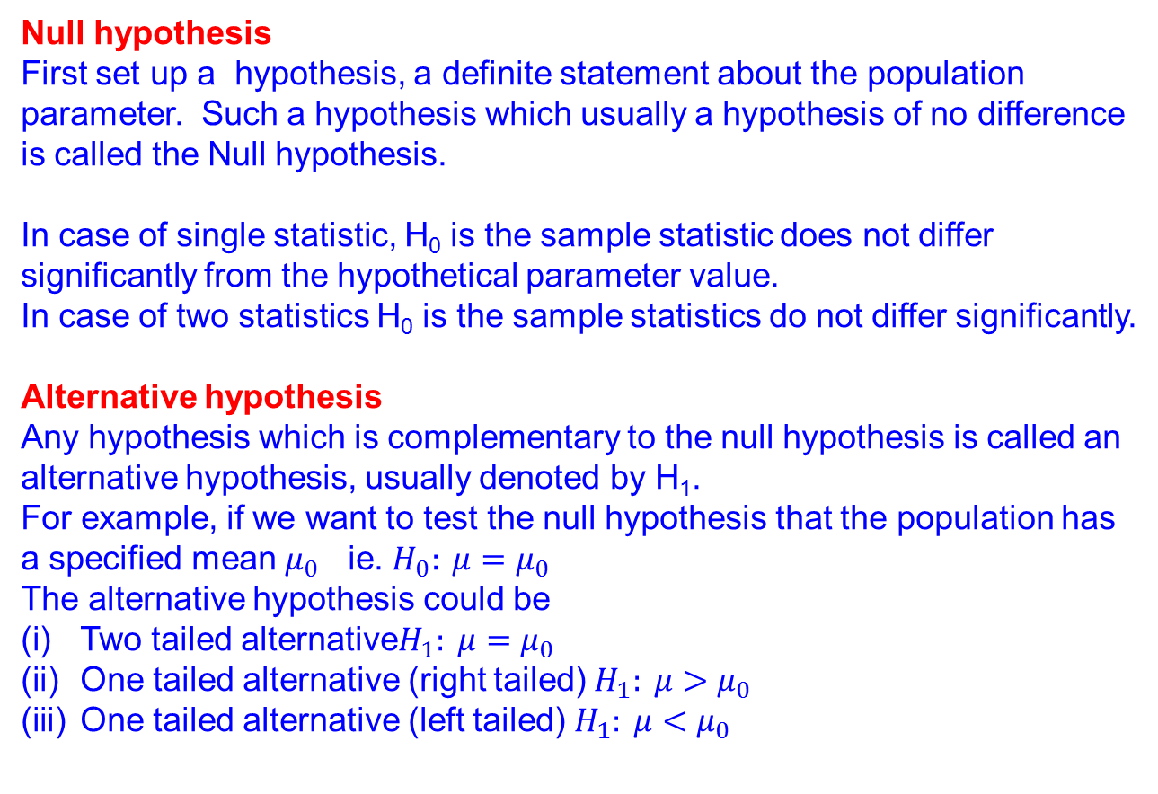
Null hypothesis
First set up a hypothesis, a definite statement about the population parameter. Such a hypothesis which usually a hypothesis of no difference is called the Null hypothesis.
In case of single statistic, H₀ is the sample statistic does not differ significantly from the hypothetical parameter value.
In case of two statistics H₀ is the sample statistics do not differ significantly.
Alternative hypothesis
Any hypothesis which is complementary to the null hypothesis is called an alternative hypothesis, usually denoted by H₁.
For example, if we want to test the null hypothesis that the population has a specified mean $μ_{0}$ ie. ${H_{0}: μ=μ}_{0}$
The alternative hypothesis could be
Two tailed alternative${H_{1}: μ=μ}_{0}$
One tailed alternative (right tailed)${{ H}_{1}: μ>μ}_{0}$
One tailed alternative (left tailed)${{ H}_{1}: μ<μ}_{0}$

Slide 13
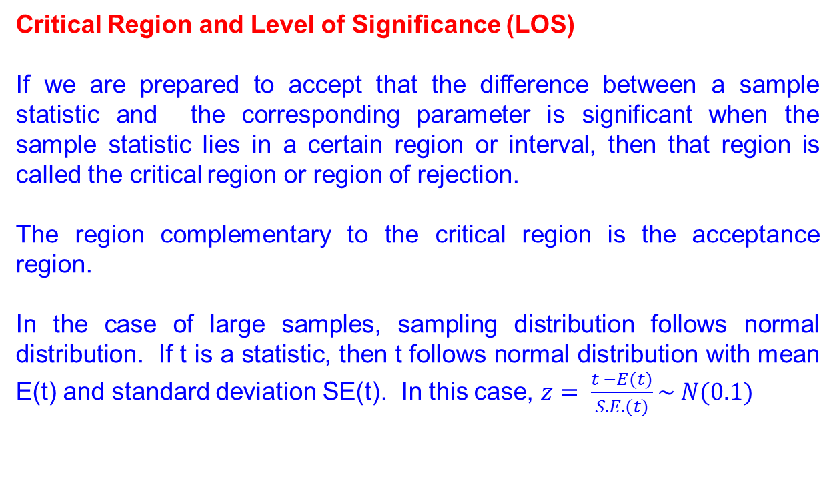
Critical Region and Level of Significance (LOS)
If we are prepared to accept that the difference between a sample statistic and the corresponding parameter is significant when the sample statistic lies in a certain region or interval, then that region is called the critical region or region of rejection.
The region complementary to the critical region is the acceptance region.
In the case of large samples, sampling distribution follows normal distribution. If t is a statistic, then t follows normal distribution with mean E(t) and standard deviation SE(t). In this case, $z= \frac{t −E(t)}{S.E.(t)}\sim N(0.1)$

Slide 14
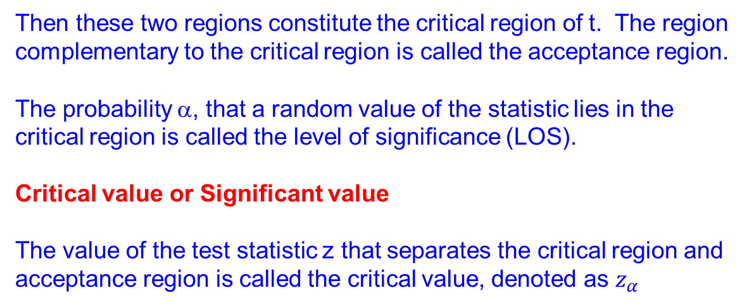
If we are prepared to accept that difference between t and E(t) is significant when t lies in either of the regions
$$\left(−∞ , t −1.96 SE\left(t\right)\right)and (t+1.96 SE\left(t\right), ∞)$$
Then these two regions constitute the critical region of t. The region complementary to the critical region is called the acceptance region.
The probability α, that a random value of the statistic lies in the critical region is called the level of significance (LOS).
Critical value or Significant value
The value of the test statistic z that separates the critical region and acceptance region is called the critical value, denoted as $z_{α}$

Slide 15
Errors in Sampling
In practice we accept or reject a lot after examining a sample from it.
As such we are liable to commit
Two types of Errors
Type I error: Reject Ho when it is true
Type II error: Accept Ho when it is wrong
So
P( Reject Ho when it is true) = P(Reject H₀/H₀)
= α
P( Accept H0 when it is true) = P( Accept H₀/H₁)
= β
α and β are called sizes of Type I and Type II errors resp.
Type I error → Rejecting a lot when it is good – producer’s risk
Type II error → Accepting a lot when it is bad – consumer’s risk

Slide 16
Interval estimation of population parameter
The interval within which the parameter is expected to lie is called the confidence interval for that parameter.
The end points of the confidence interval are called confidence limits.
95% confidence limits are derived from
P(t – 1.96SE(t), t +1.96SE(t)) = 0.95
This means that 95% confidence limits are
(t – 1.96SE(t), t +1.96SE(t))
The 99% confidence limits are
(t – 2.58SE(t), t +2.58SE(t))

Slide 17
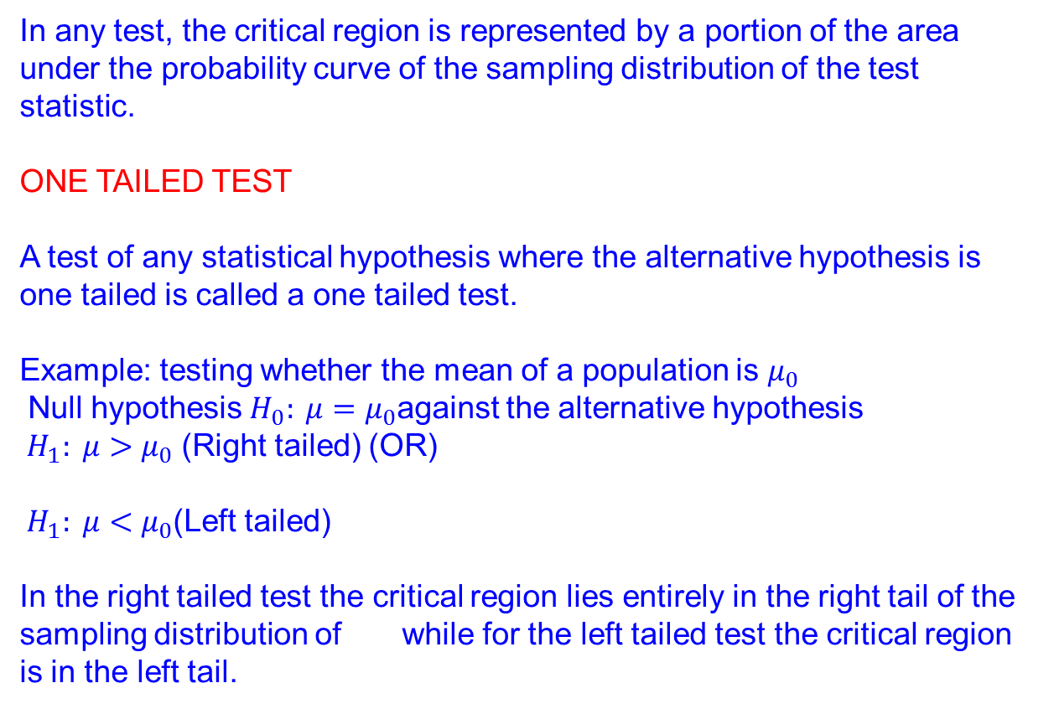
In any test, the critical region is represented by a portion of the area under the probability curve of the sampling distribution of the test statistic.
ONE TAILED TEST
A test of any statistical hypothesis where the alternative hypothesis is one tailed is called a one tailed test.
Example: testing whether the mean of a population is $μ_{0}$
Null hypothesis${{ H}_{0}: μ=μ}_{0}$against the alternative hypothesis
${{ H}_{1}: μ>μ}_{0}$ (Right tailed) (OR)
${{ H}_{1}: μ<μ}_{0}$(Left tailed)
In the right tailed test the critical region lies entirely in the right tail of the sampling distribution of while for the left tailed test the critical region is in the left tail.

Slide 18
TWO TAILED TEST
A test of statistical hypothesis where the alternative hypothesis is two tailed such as
H₀ = μ = μ_{o} against
H₁ : μ ≠ μ_{o}
Is known as two tailed test. In this case the critical region is given by the portion of the area lying in both the tails of the probability curve of the test statistic.
Thus in a particular problem, whether one tailed or two tailed test is to be applied depends on the nature of the alternate hypothesis.
Critical Values or Significant Values
The values of test statistic which separates the critical region
(rejection region) and the acceptance region is called the critical value or significant value. It depends upon:
The level of significance
The alternative hypothesis

Slide 19
Steps involved in test of hypothesis
State the Null hypothesis
State the Alternative hypothesis
Calculate the test statistic
State the level of significance
State the critical value
State the conclusion

Slide 20
LARGE SAMPLE TEST
For large samples, ie. When sample size is greater than 30, the test statistic follows normal distribution.
Table for critical values on using the normal probability
Critical values | Level of significance
 | 1% | 5% | 10%
Two -tailed Test | |z| = 2.58 | |z| = 1.96 | |z| = 1.96
Right-tailed Test | Z = 2.33 | Z=1.645 | Z =1.28
Left-tailed Test | Z = -2.33 | Z=-1.645 | Z =-1.28

Slide 21
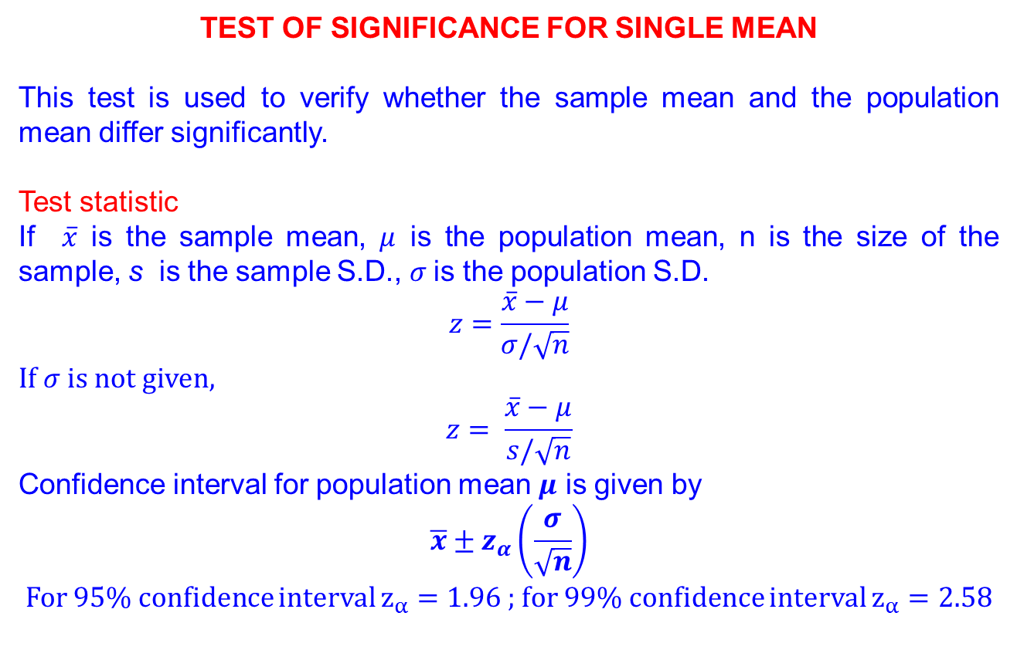
Test of significance for single mean
This test is used to verify whether the sample mean and the population mean differ significantly.
Test statistic
If $\overline{x}$ is the sample mean, $μ$ is the population mean, n is the size of the sample, s is the sample S.D., $σ$is the population S.D.
$$z=\frac{\overline{x}−μ}{σ/\sqrt{n}}$$
If $σ$ is not given,
$$z= \frac{\overline{x}−μ}{s/\sqrt{n}}$$
Confidence interval for population mean $μ$ is given by
$$\overline{x}±z_{α}\left(\frac{σ}{\sqrt{n}}\right)$$
For 95% confidence interval $z_{α}=1.96$ ; for 99% confidence interval $z_{α}=2.58$

Slide 22
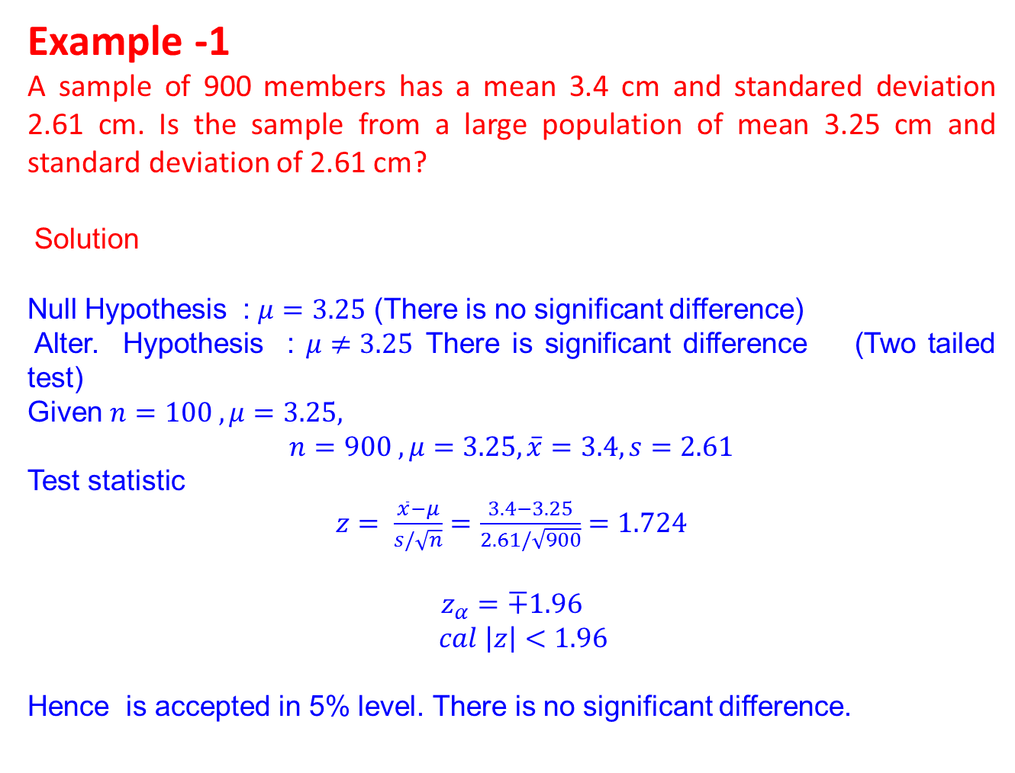
Example -1
A sample of 900 members has a mean 3.4 cm and standared deviation 2.61 cm. Is the sample from a large population of mean 3.25 cm and standard deviation of 2.61 cm?
Solution
Null Hypothesis : $μ=3.25$ (There is no significant difference)
Alter. Hypothesis : $μ≠3.25$ There is significant difference (Two tailed test)
Given $n=100 , μ=3.25,$
$$n=900 , μ=3.25, \overline{x}=3.4, s=2.61$$
Test statistic
$z= \frac{\overline{x}−μ}{s/\sqrt{n}}=\frac{3.4−3.25}{2.61/\sqrt{900}}=1.724$
$$z_{α}=∓1.96$$
$cal \left|z\right|<1.96$
Hence is accepted in 5% level. There is no significant difference.

Slide 23
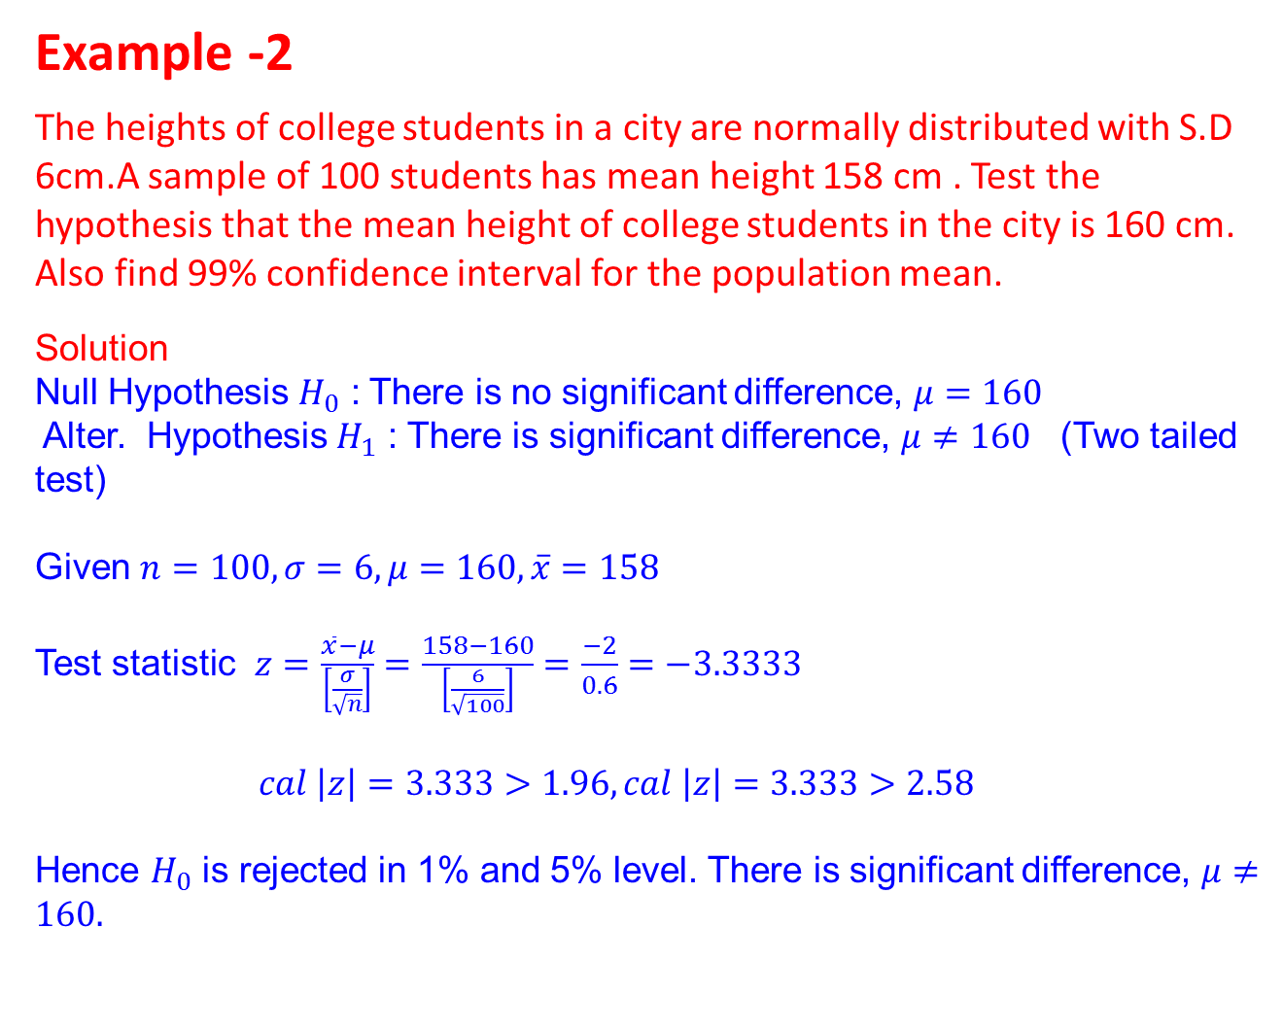
Example -2
The heights of college students in a city are normally distributed with S.D 6cm.A sample of 100 students has mean height 158 cm . Test the hypothesis that the mean height of college students in the city is 160 cm. Also find 99% confidence interval for the population mean.
Solution
Null Hypothesis $H_{0}$ : There is no significant difference, $μ=160$
Alter. Hypothesis $H_{1}$ : There is significant difference, $μ≠160$ (Two tailed test)
Given $n=100,σ=6, μ=160,\overline{x}=158$
Test statistic $z=\frac{\overline{x}−μ}{\left[\frac{σ}{\sqrt{n}}\right]}=\frac{158−160}{\left[\frac{6}{\sqrt{100}}\right]}=\frac{−2}{0.6}=−3.3333$
$cal \left|z\right|=3.333>1.96, cal \left|z\right|=3.333>2.58$
Hence $H_{0}$ is rejected in 1% and 5% level. There is significant difference, $μ≠160.$

Slide 24
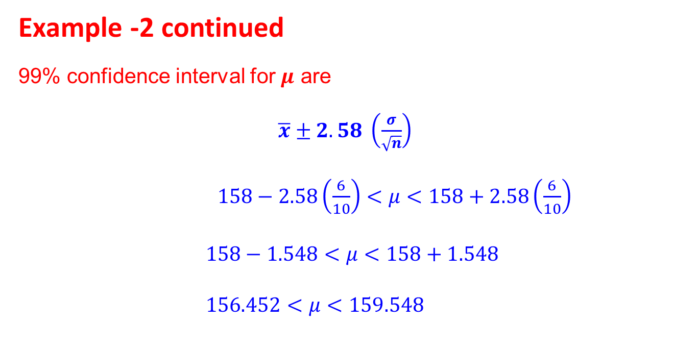
Example -2 continued
99% confidence interval for $μ$ are
$\overline{x}±2.58 \left(\frac{σ}{\sqrt{n}}\right)$
$158−2.58\left(\frac{6}{10}\right)<μ<158+2.58\left(\frac{6}{10}\right)$
$158−1.548<μ<158+1.548$
$156.452<μ<159.548$

Slide 25
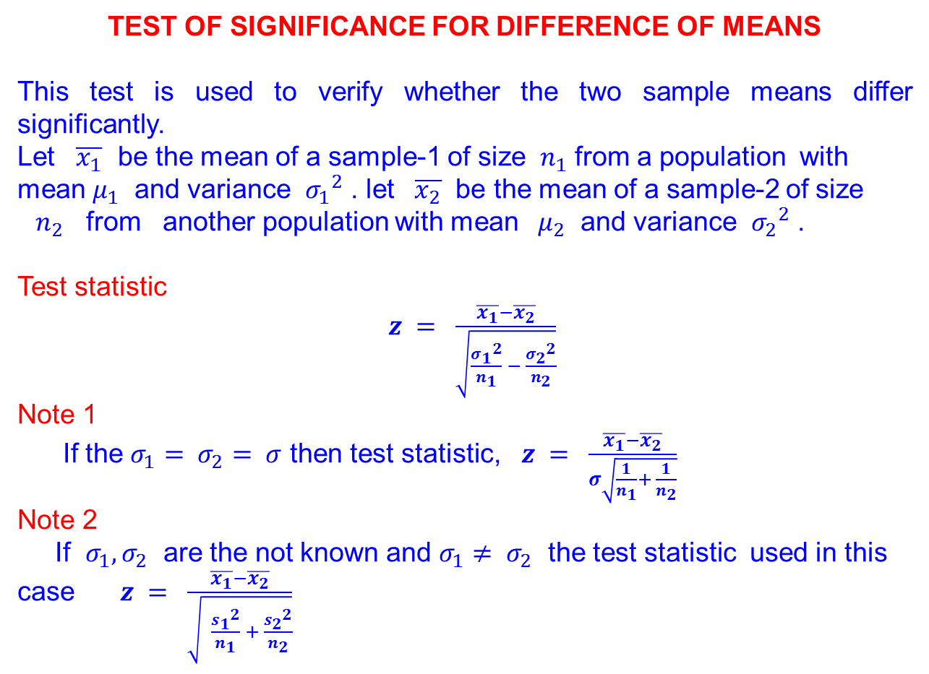
Test of significance for difference of means
This test is used to verify whether the two sample means differ significantly.
Let $\overline{x_{1}}$ be the mean of a sample-1 of size $n_{1}$ from a population with mean $μ_{1}$ and variance ${σ_{1}}^{2}$ . let $\overline{x_{2}}$ be the mean of a sample-2 of size ${ n}_{2}$ from another population with mean $μ_{2}$ and variance ${σ_{2}}^{2}$ .
Test statistic
$z = \frac{\overline{x_{1}}−\overline{x_{2}}}{\sqrt{\frac{{σ_{1}}^{2}}{n_{1}} − \frac{{σ_{2}}^{2}}{n_{2}}}}$
Note 1
If the $σ_{1}= σ_{2}= σ$ then test statistic, $z = \frac{\overline{x_{1}}−\overline{x_{2}}}{σ\sqrt{\frac{1}{n_{1}}+ \frac{1}{n_{2}}}}$
Note 2
If $σ_{1}, σ_{2}$ are the not known and $σ_{1}≠ σ_{2}$ the test statistic used in this case $z = \frac{\overline{x_{1}}−\overline{x_{2}}}{\sqrt{ \frac{{s_{1}}^{2}}{n_{1}} + \frac{{s_{2}}^{2}}{n_{2}}}}$

Slide 26
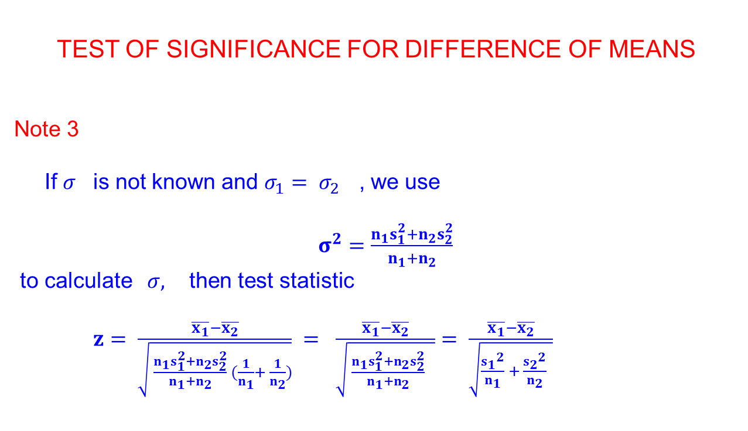
Test of significance for difference of means
Note 3
If $σ$ is not known and $σ_{1}= σ_{2}$ , we use
$σ^{2}=\frac{n_{1}s_{1}^{2}+n_{2}s_{2}^{2}}{n_{1}+n_{2}}$
to calculate $σ,$ then test statistic
$z= \frac{\overline{x_{1}}−\overline{x_{2}}}{\sqrt{ \frac{n_{1}s_{1}^{2}+n_{2}s_{2}^{2}}{n_{1}+n_{2}} (\frac{1}{n_{1}}+ \frac{1}{n_{2}})}} = \frac{\overline{x_{1}}−\overline{x_{2}}}{\sqrt{ \frac{n_{1}s_{1}^{2}+n_{2}s_{2}^{2}}{n_{1}+n_{2}} }}= \frac{\overline{x_{1}}−\overline{x_{2}}}{\sqrt{\frac{{s_{1}}^{2}}{n_{1}} + \frac{{s_{2}}^{2}}{n_{2}} }}$

Slide 27
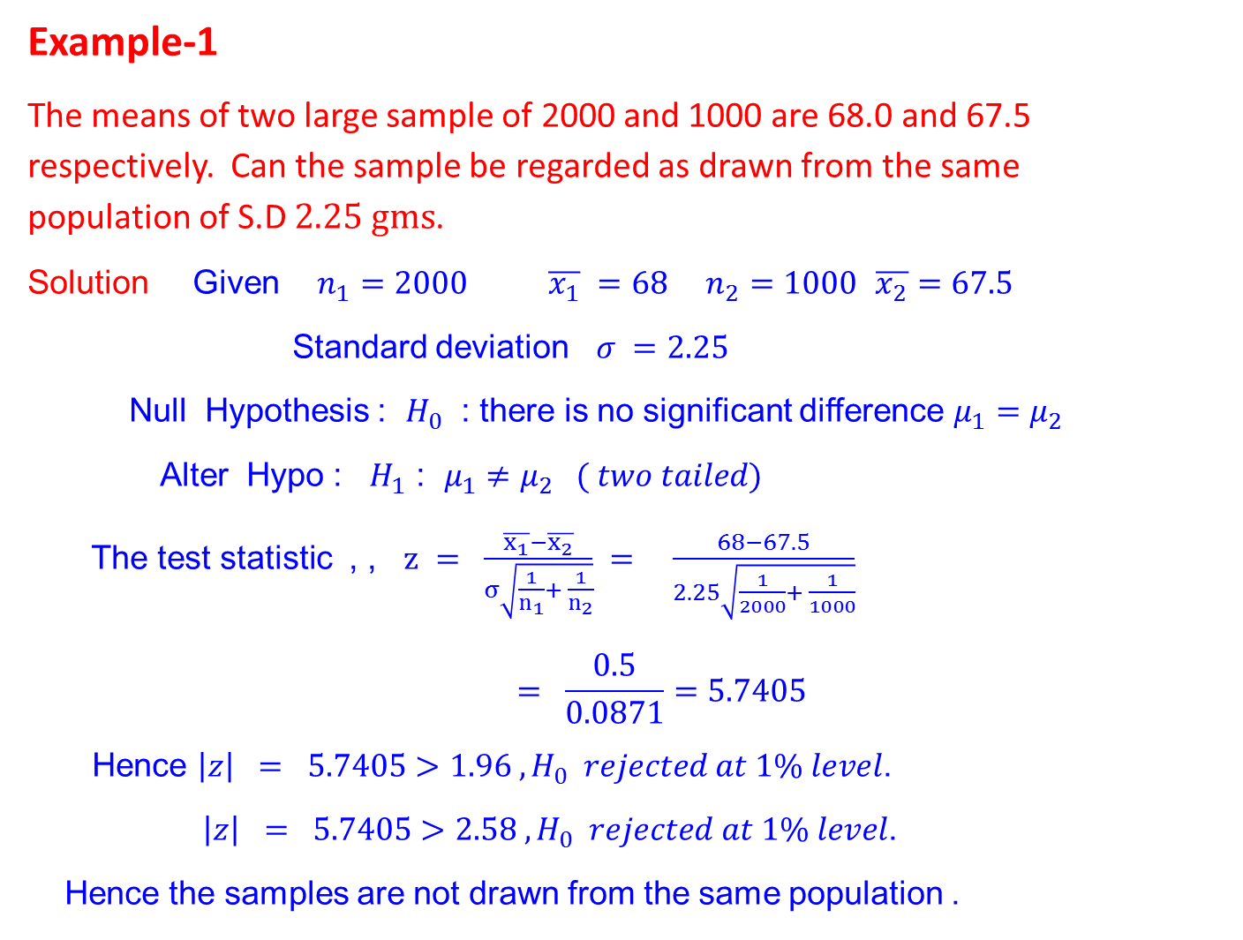
Example-1
The means of two large sample of 2000 and 1000 are 68.0 and 67.5 respectively. Can the sample be regarded as drawn from the same population of S.D $2.25 gms$.
Solution Given $n_{1}=2000 \overline{x_{1}} =68$ $n_{2}=1000$ $\overline{x_{2}}=67.5$
Standard deviation $σ =2.25$
Null Hypothesis : $H_{0}$ : there is no significant difference $μ_{1}=μ_{2}$
Alter Hypo : $H_{1}$ : $μ_{1}≠μ_{2} ( two tailed)$
The test statistic , , $z = \frac{\overline{x_{1}}−\overline{x_{2}}}{σ\sqrt{\frac{1}{n_{1}}+ \frac{1}{n_{2}}}} = \frac{68−67.5}{2.25\sqrt{\frac{1}{2000}+ \frac{1}{1000}}}$
$$= \frac{0.5}{0.0871}=5.7405$$
Hence $\left|z\right| = 5.7405>1.96 , H_{0} rejected at 1\% level$.
$\left|z\right| = 5.7405>2.58 , H_{0} rejected at 1\% level$.
Hence the samples are not drawn from the same population .

Slide 28
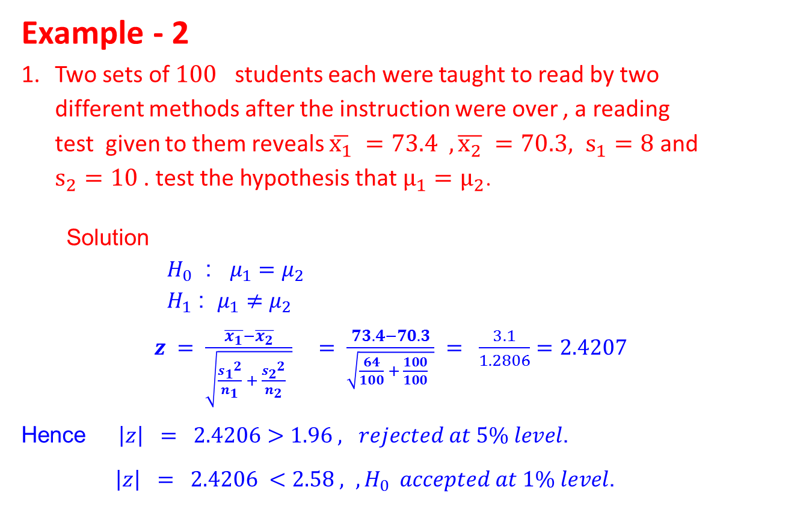
Example - 2
Two sets of $100$ students each were taught to read by two different methods after the instruction were over , a reading test given to them reveals $\overline{x_{1}} =73.4 ,\overline{x_{2}} =70.3, s_{1}=8$ and $s_{2}=10$ . test the hypothesis that $μ_{1}=μ_{2}$.
Solution
$H_{0}$ : $μ_{1}=μ_{2}$
$H_{1}$ : $μ_{1}≠μ_{2}$
$z = \frac{\overline{x_{1}}−\overline{x_{2}}}{\sqrt{\frac{{s_{1}}^{2}}{n_{1}} + \frac{{s_{2}}^{2}}{n_{2}} }} = \frac{73.4−70.3}{\sqrt{\frac{64}{100} + \frac{100}{100} }} = \frac{3.1}{1.2806}=2.4207$
Hence $\left|z\right| = 2.4206>1.96 , rejected at 5\% level$.
$\left|z\right| = 2.4206 <2.58 , , H_{0} accepted at 1\% level$.

Slide 29
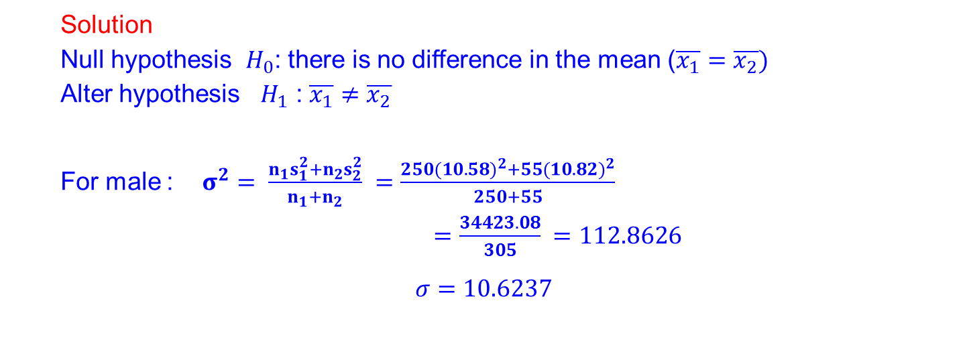
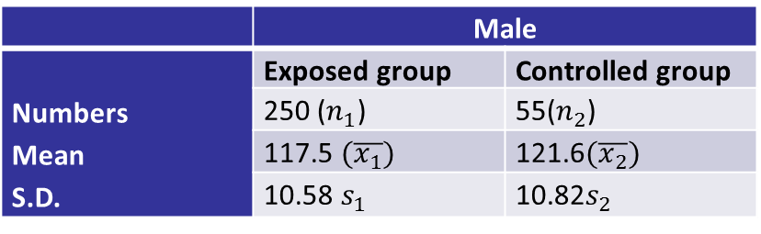
Example - 3
In a study of the effect of chemicals on the laborers is a chemical Unit, the following results were obtained on their systolic blood examine whether difference in the blood pressures are significant.
 | Male
Numbers Mean S.D. | Exposed group | Controlled group
 | 250 ($n_{1}$) | 55($n_{2}$)
 | 117.5 $(\overline{x_{1}})$ | 121.6$(\overline{x_{2}})$
 | 10.58 $s_{1}$ | 10.82$s_{2}$
Solution
Null hypothesis $H_{0}$: there is no difference in the mean ($\overline{x_{1}}=\overline{x_{2}})$
Alter hypothesis $H_{1}$ : $\overline{x_{1}}≠\overline{x_{2}}$
For male : $σ^{2}= \frac{n_{1}s_{1}^{2}+n_{2}s_{2}^{2}}{n_{1}+n_{2}} =\frac{250{(10.58)}^{2}+55({10.82)}^{2}}{250+55}$
$=\frac{34423.08}{305} =112.8626$
$$σ=10.6237$$

Slide 30
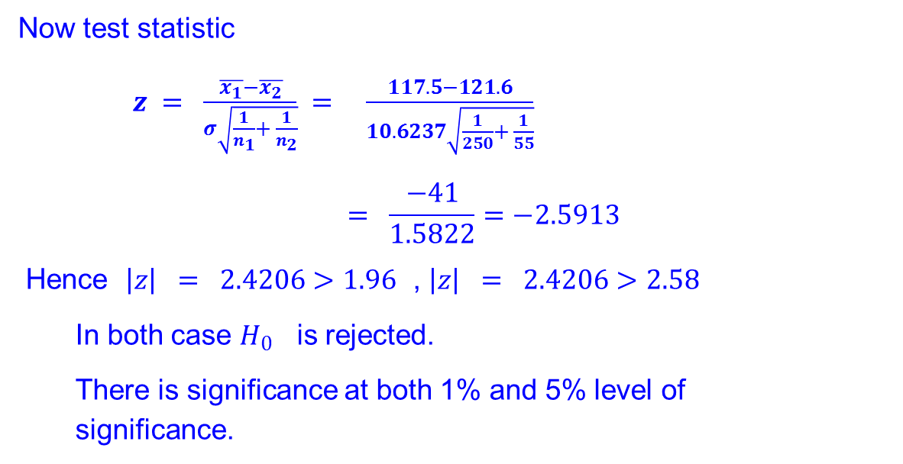
Now test statistic
$z = \frac{\overline{x_{1}}−\overline{x_{2}}}{σ\sqrt{\frac{1}{n_{1}}+ \frac{1}{n_{2}}}} = \frac{117.5−121.6}{10.6237\sqrt{\frac{1}{250}+ \frac{1}{55}}}$
$$= \frac{−41}{1.5822}=−2.5913$$
Hence $\left|z\right| = 2.4206>1.96$ , $\left|z\right| = 2.4206>2.58$
In both case $H_{0}$ is rejected.
There is significance at both 1% and 5% level of significance.

Slide 31
SMALL SAMPLE TEST
For large samples, ie. When sample size is LESS than 30, the test statistic follows ‘student’s t-distribution’ or t-distribution.
Applications of t-distribution
It is used to test the significance of the difference of the mean of a random sample and the mean of the population.
It is used to test the significance of the difference between two sample means.
To test the significance of an observed sample correlation coefficient and sample regression coefficient.
To test the significance of observed partial and multiple correlation coefficients.

Slide 32
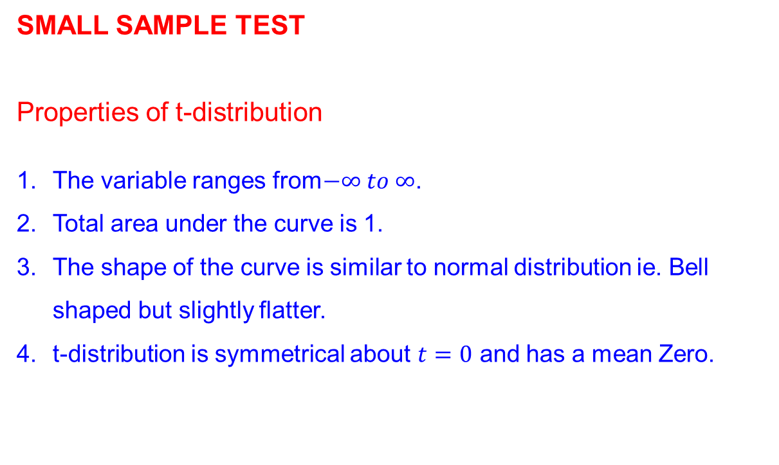
SMALL SAMPLE TEST
Properties of t-distribution
The variable ranges from$−∞ to ∞$.
Total area under the curve is 1.
The shape of the curve is similar to normal distribution ie. Bell shaped but slightly flatter.
t-distribution is symmetrical about $t=0$ and has a mean Zero.

Slide 33

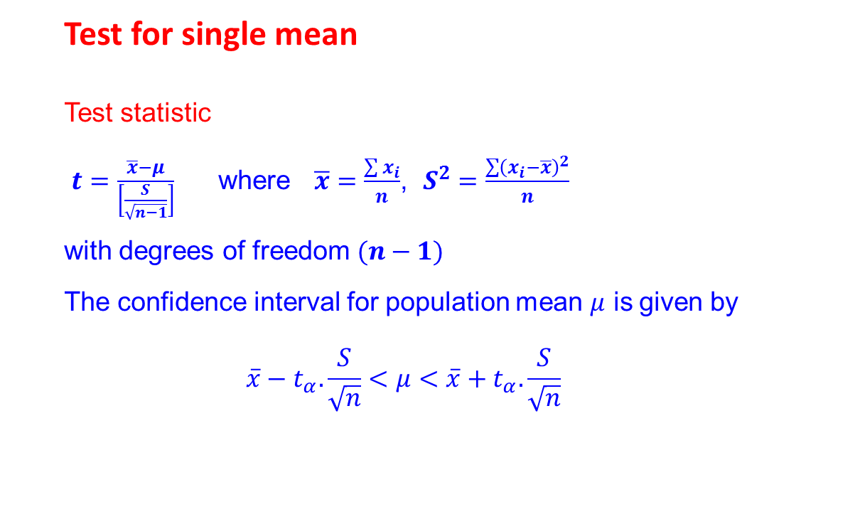
Test for single mean
Test statistic
$t=\frac{\overline{x}−μ}{\left[\frac{S}{\sqrt{n−1}}\right]}$ where$\overline{x}=\frac{\sum{x_{i}}}{n}$, $S^{2}=\frac{\sum{{\left(x_{i}−\overline{x}\right)}^{2}}}{n}$
with degrees of freedom $(n−1)$
The confidence interval for population mean $μ$ is given by
$$\overline{x}−t_{α}.\frac{S}{\sqrt{n}}<μ<\overline{x}+t_{α}.\frac{S}{\sqrt{n}}$$
Note
For finding the critical values ($t_{α}$) t-distribution table is used.

Slide 34
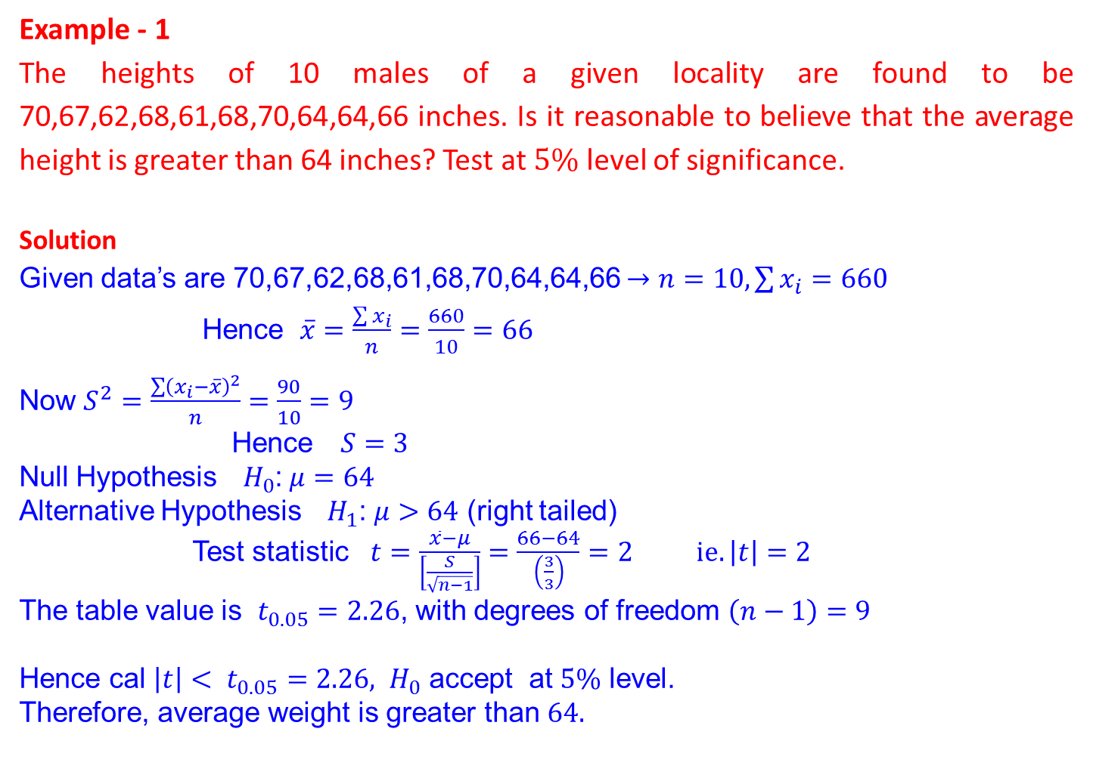
Example - 1
The heights of 10 males of a given locality are found to be 70,67,62,68,61,68,70,64,64,66 inches. Is it reasonable to believe that the average height is greater than 64 inches? Test at $5\%$ level of significance.
Solution
Given data’s are 70,67,62,68,61,68,70,64,64,66 $→n=10,\sum{x_{i}=660}$
Hence $\overline{x}=\frac{\sum{x_{i}}}{n}=\frac{660}{10}=66$
Now $S^{2}=\frac{\sum{{\left(x_{i}−\overline{x}\right)}^{2}}}{n}$ $=\frac{90}{10}=9$
Hence $S=3$
Null Hypothesis${ H}_{0}$: $μ=64$
Alternative Hypothesis${ H}_{1}$: $μ>64$ (right tailed)
Test statistic $t=\frac{\overline{x}−μ}{\left[\frac{S}{\sqrt{n−1}}\right]}=\frac{66−64}{\left(\frac{3}{3}\right)}=2 ie.\left|t\right|=2$
The table value is $t_{0.05}=2.26$, with degrees of freedom $\left(n−1\right)=9$
Hence cal $\left|t\right|< t_{0.05}=2.26,$ ${ H}_{0}$ accept at $5\%$ level.
Therefore, average weight is greater than $64.$

Slide 35
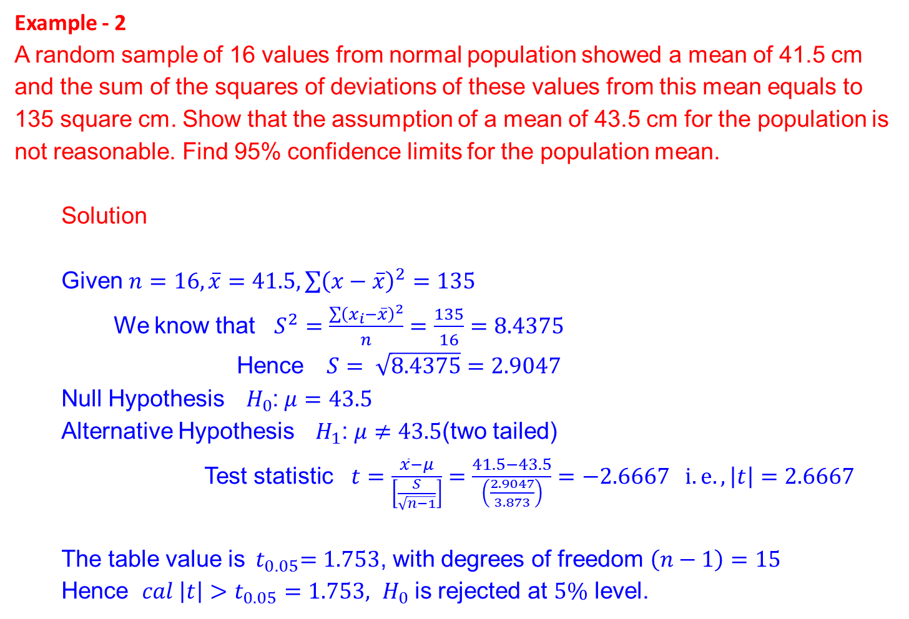
Example - 2
A random sample of 16 values from normal population showed a mean of 41.5 cm and the sum of the squares of deviations of these values from this mean equals to 135 square cm. Show that the assumption of a mean of 43.5 cm for the population is not reasonable. Find 95% confidence limits for the population mean.
Solution
Given $n=16,\overline{x}=41.5,\sum{{\left(x−\overline{x}\right)}^{2}}=135$
We know that $S^{2}=\frac{\sum{{\left(x_{i}−\overline{x}\right)}^{2}}}{n}=\frac{135}{16}=8.4375$
Hence $S= \sqrt{8.4375}=2.9047$
Null Hypothesis${ H}_{0}$: $μ=43.5$
Alternative Hypothesis${ H}_{1}$: $μ≠43.5$(two tailed)
Test statistic $t=\frac{\overline{x}−μ}{\left[\frac{S}{\sqrt{n−1}}\right]}=\frac{41.5−43.5}{\left(\frac{2.9047}{3.873}\right)}=−2.6667 i.e., \left|t\right|=2.6667$
The table value is${ t}_{0.05}=1.753$, with degrees of freedom $\left(n−1\right)=15$
Hence $cal \left|t\right|>t_{0.05}=1.753,$ ${ H}_{0}$ is rejected at $5\%$ level.

Slide 36
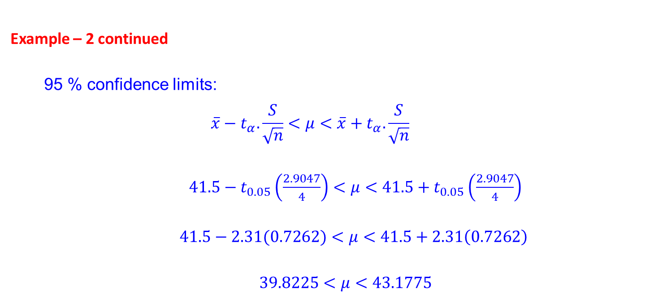
Example – 2 continued
95 % confidence limits:
$$\overline{x}−t_{α}.\frac{S}{\sqrt{n}}<μ<\overline{x}+t_{α}.\frac{S}{\sqrt{n}}$$
$41.5−t_{0.05}\left(\frac{2.9047}{4}\right)<μ<41.5+t_{0.05}\left(\frac{2.9047}{4}\right)$
$41.5−2.31(0.7262)<μ<41.5+2.31\left(0.7262\right)$
$39.8225<μ<43.1775$

Slide 37
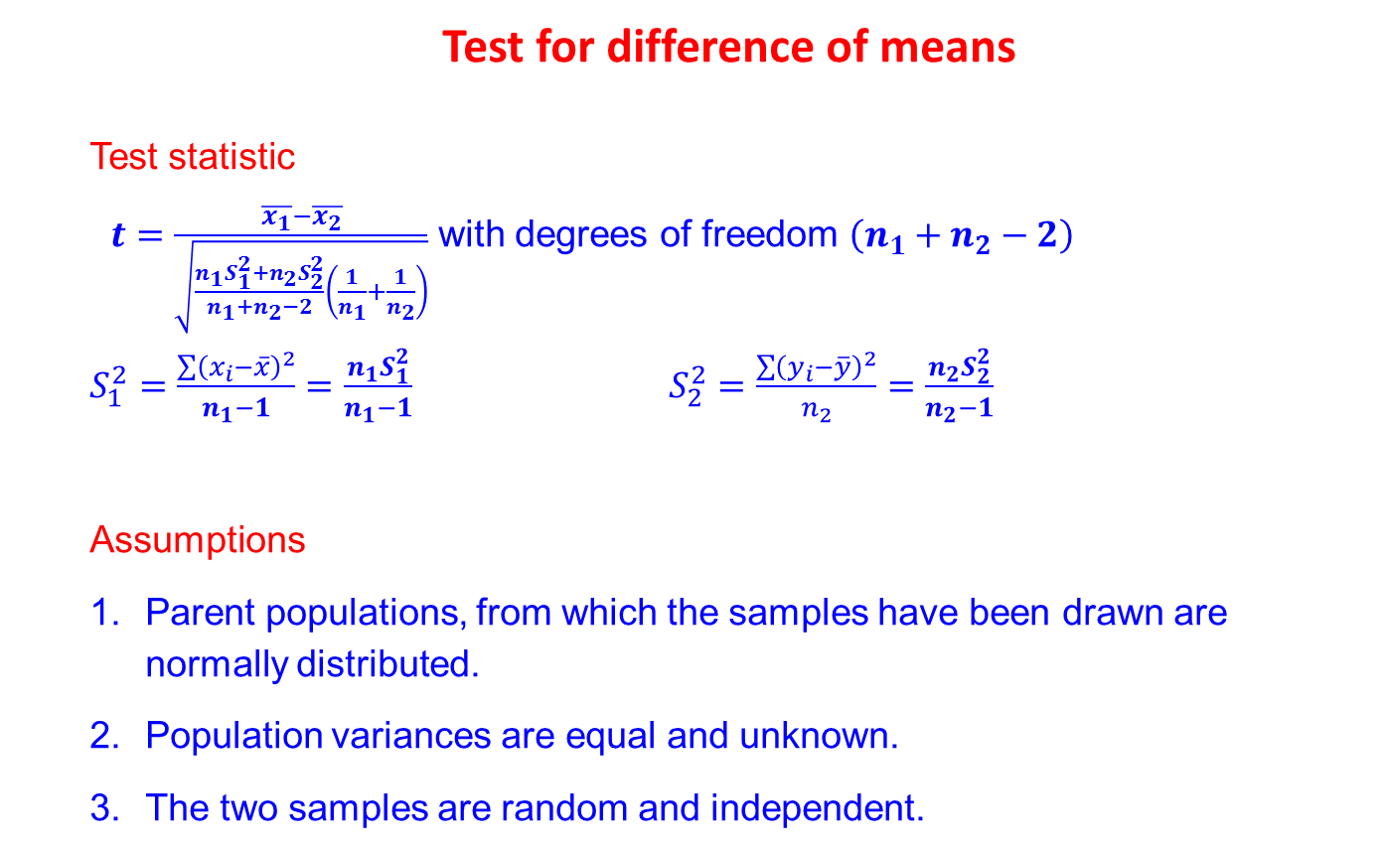
Test for difference of means
Test statistic
$t=\frac{\overline{x_{1}}−\overline{x_{2}}}{\sqrt{\frac{n_{1}S_{1}^{2}+n_{2}S_{2}^{2}}{n_{1}+n_{2}−2}\left(\frac{1}{n_{1}}+\frac{1}{n_{2}}\right)}}$ with degrees of freedom $\left(n_{1}+n_{2}−2\right)$
$S_{1}^{2}=\frac{\sum{{\left(x_{i}−\overline{x}\right)}^{2}}}{n_{1}−1}=\frac{n_{1}S_{1}^{2}}{n_{1}−1}$ $S_{2}^{2}=\frac{\sum{{\left(y_{i}−\overline{y}\right)}^{2}}}{n_{2}}=\frac{n_{2}S_{2}^{2}}{n_{2}−1}$
Assumptions
Parent populations, from which the samples have been drawn are normally distributed.
Population variances are equal and unknown.
The two samples are random and independent.

Slide 38
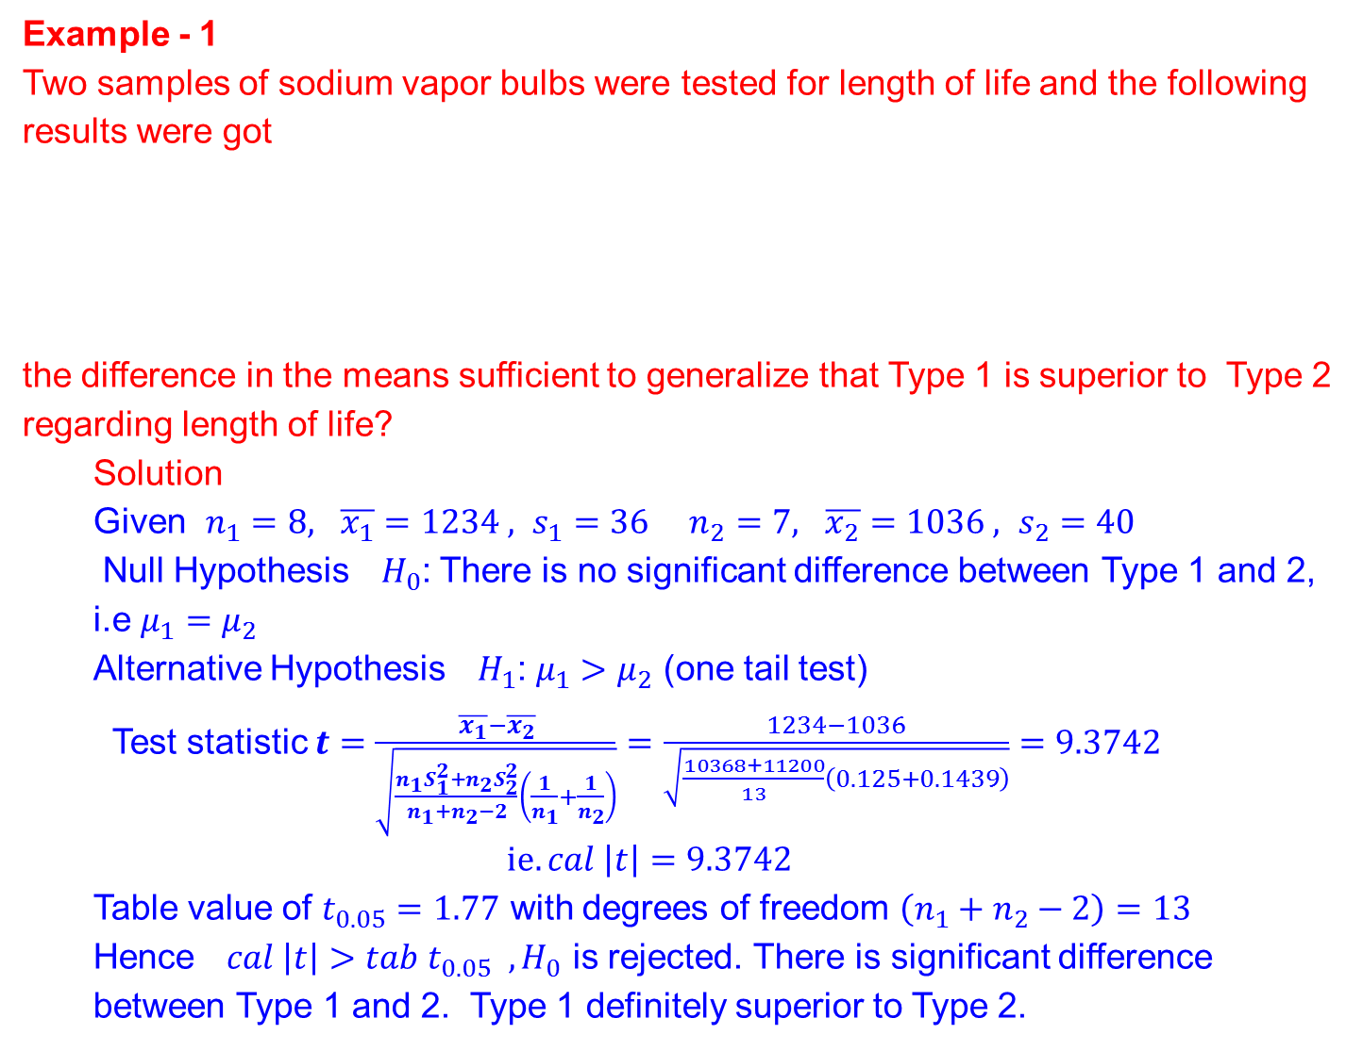
Example - 1
Two samples of sodium vapor bulbs were tested for length of life and the following results were got
the difference in the means sufficient to generalize that Type 1 is superior to Type 2 regarding length of life?
Solution
Given $n_{1}=8, \overline{x_{1}}=1234 , s_{1}=36$ $n_{2}=7, \overline{x_{2}}=1036 , s_{2}=40$
Null Hypothesis${ H}_{0}$: There is no significant difference between Type 1 and 2, i.e $μ_{1}=μ_{2}$
Alternative Hypothesis${ H}_{1}$: $μ_{1}>μ_{2}$ (one tail test)
Test statistic $t=\frac{\overline{x_{1}}−\overline{x_{2}}}{\sqrt{\frac{n_{1}S_{1}^{2}+n_{2}S_{2}^{2}}{n_{1}+n_{2}−2}\left(\frac{1}{n_{1}}+\frac{1}{n_{2}}\right)}}=\frac{1234−1036}{\sqrt{\frac{10368+11200}{13}\left(0.125+0.1439\right)}}=9.3742$
$$ie.cal \left|t\right|=9.3742$$
Table value of $t_{0.05}=1.77$ with degrees of freedom $\left(n_{1}+n_{2}−2\right)=13$
Hence$cal \left|t\right|>tab t_{0.05} , H_{0}$ is rejected. There is significant difference between Type 1 and 2. Type 1 definitely superior to Type 2.
 | Sample size | Sample mean | Sample S.D.
Type 1 | 8 | 1234 | 36
Type 2 | 7 | 1036 | 40

Slide 39
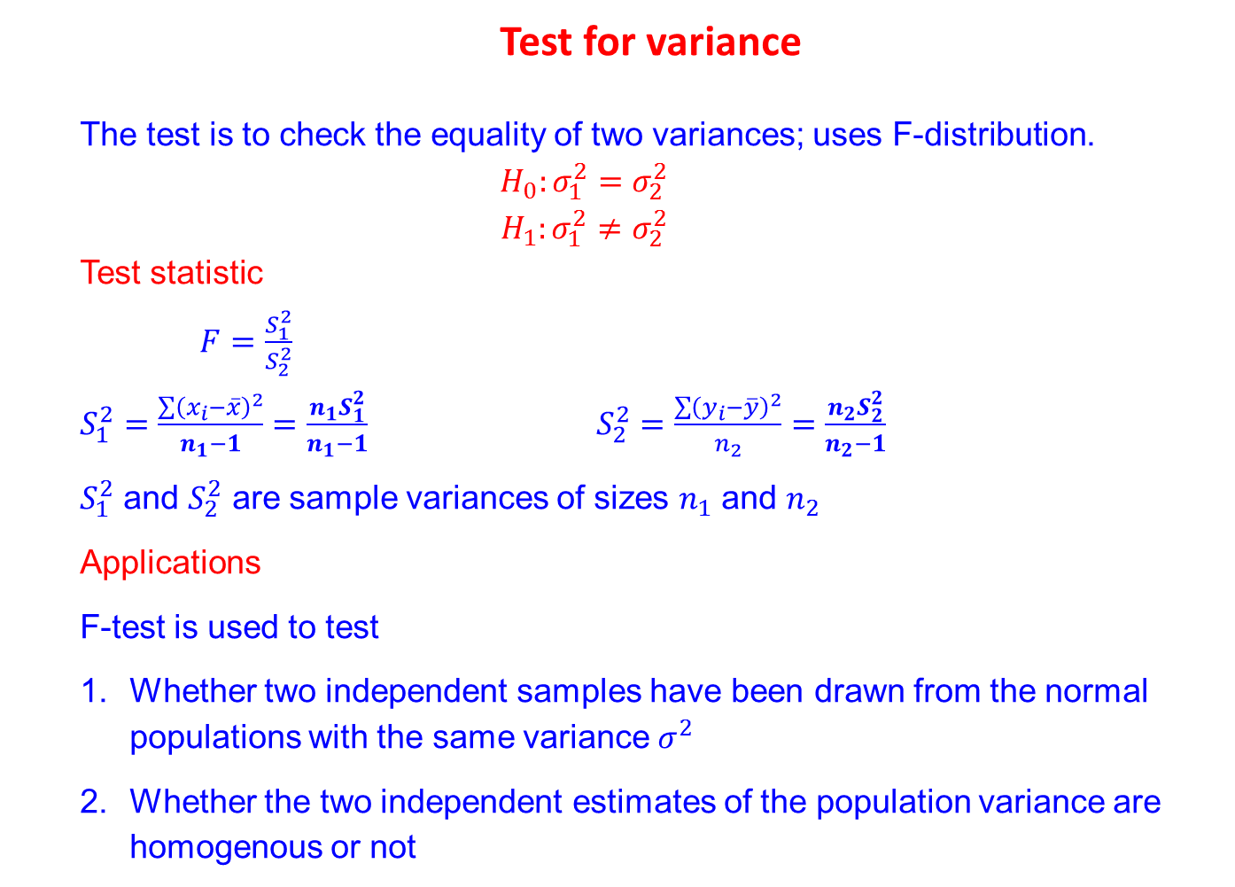
Test for variance
The test is to check the equality of two variances; uses F-distribution.
$$H_{0}:σ_{1}^{2}=σ_{2}^{2}$$
$$H_{1}:σ_{1}^{2}≠σ_{2}^{2}$$
Test statistic
$F=\frac{S_{1}^{2}}{S_{2}^{2}}$
$S_{1}^{2}=\frac{\sum{{\left(x_{i}−\overline{x}\right)}^{2}}}{n_{1}−1}=\frac{n_{1}S_{1}^{2}}{n_{1}−1}$ $S_{2}^{2}=\frac{\sum{{\left(y_{i}−\overline{y}\right)}^{2}}}{n_{2}}=\frac{n_{2}S_{2}^{2}}{n_{2}−1}$
$S_{1}^{2}$ and $S_{2}^{2}$ are sample variances of sizes $n_{1}$ and $n_{2}$
Applications
F-test is used to test
Whether two independent samples have been drawn from the normal populations with the same variance $σ^{2}$
Whether the two independent estimates of the population variance are homogenous or not

Slide 40
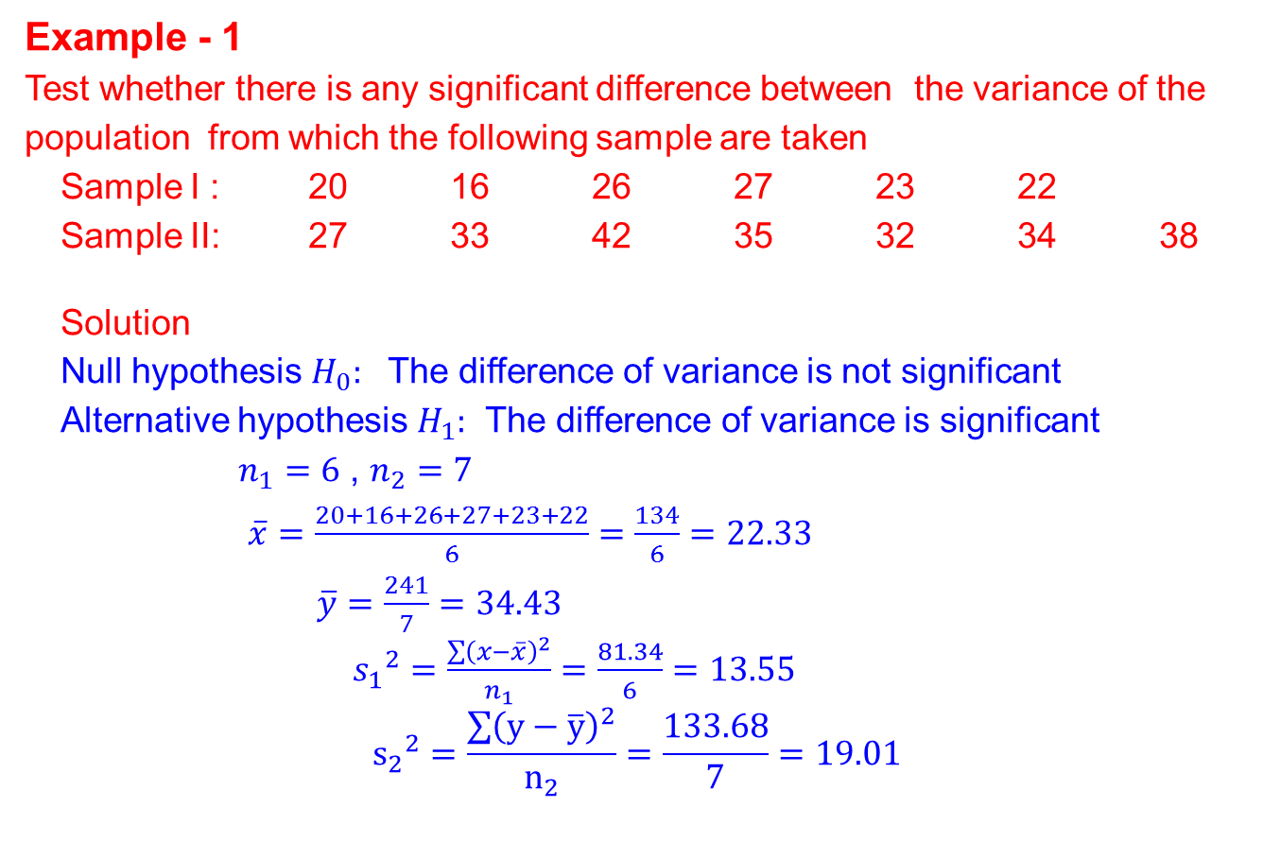
Example - 1
Test whether there is any significant difference between the variance of the population from which the following sample are taken
Sample I : 20 16 26 27 23 22
Sample II: 27 33 42 35 32 34 38
Solution
Null hypothesis $H_{0}:$ The difference of variance is not significant
Alternative hypothesis $H_{1}:$ The difference of variance is significant
$n_{1}=6$ , $n_{2}=7$
$\overline{x}=\frac{20+16+26+27+23+22}{6}=\frac{134}{6}=22.33$
$\overline{y}=\frac{241}{7}=34.43$
${s_{1}}^{2}=\frac{\sum{{\left(x−\overline{x}\right)}^{2}}}{n_{1}}=\frac{81.34}{6}=13.55$
$${s_{2}}^{2}=\frac{\sum{{\left(y−\overline{y}\right)}^{2}}}{n_{2}}=\frac{133.68}{7}=19.01$$

Slide 41
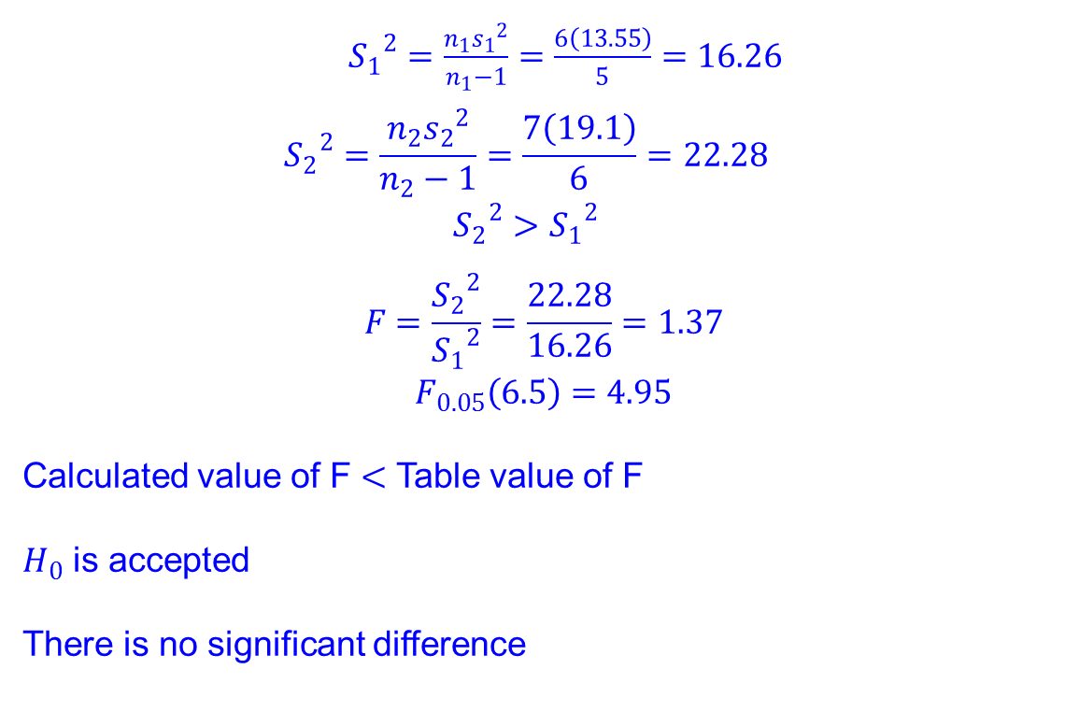
${S_{1}}^{2}=\frac{n_{1}{s_{1}}^{2}}{n_{1}−1}=\frac{6\left(13.55\right)}{5}=16.26$
$${S_{2}}^{2}=\frac{n_{2}{s_{2}}^{2}}{n_{2}−1}=\frac{7\left(19.1\right)}{6}=22.28$$
$${S_{2}}^{2}>{S_{1}}^{2}$$
$$F=\frac{{S_{2}}^{2}}{{S_{1}}^{2}}=\frac{22.28}{16.26}=1.37$$
$$F_{0.05}\left(6.5\right)=4.95$$
Calculated value of F $<$ Table value of F
$H_{0}$ is accepted
There is no significant difference

Slide 42
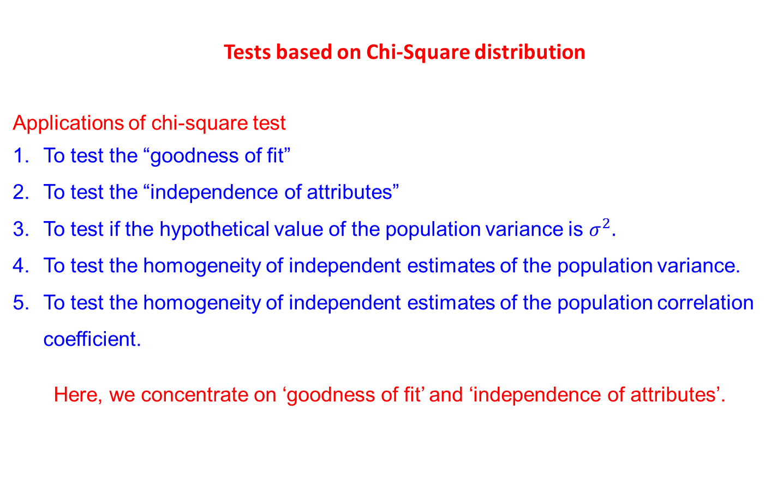
Tests based on Chi-Square distribution
Applications of chi-square test
To test the “goodness of fit”
To test the “independence of attributes”
To test if the hypothetical value of the population variance is $σ^{2}.$
To test the homogeneity of independent estimates of the population variance.
To test the homogeneity of independent estimates of the population correlation coefficient.
Here, we concentrate on ‘goodness of fit’ and ‘independence of attributes’.

Slide 43
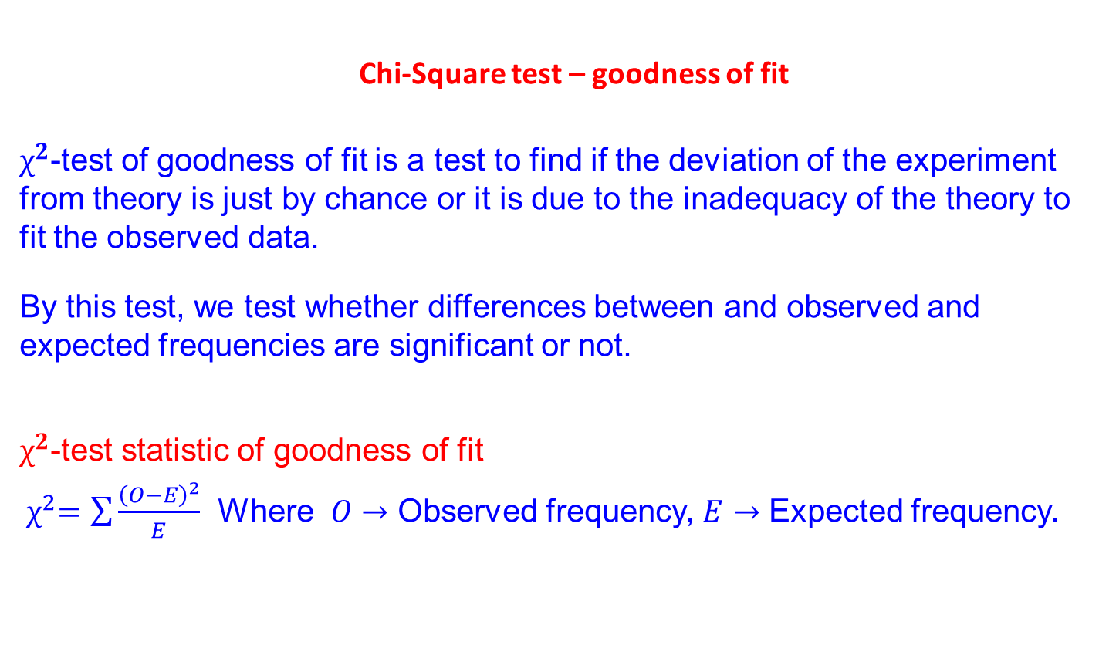
Chi-Square test – goodness of fit
$χ^{2}$-test of goodness of fit is a test to find if the deviation of the experiment from theory is just by chance or it is due to the inadequacy of the theory to fit the observed data.
By this test, we test whether differences between and observed and expected frequencies are significant or not.
$χ^{2}$-test statistic of goodness of fit
${ χ}^{2}=\sum{\frac{{\left(O−E\right)}^{2}}{E}}$ Where $O→$ Observed frequency, $E→$ Expected frequency.

Slide 44
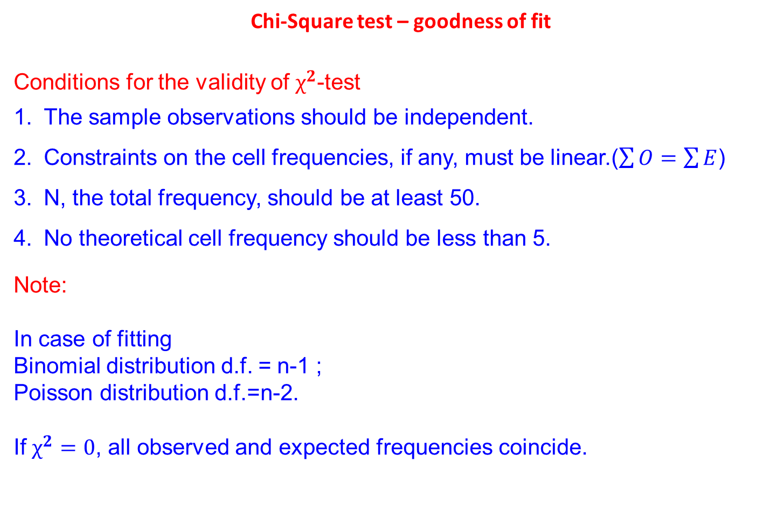
Chi-Square test – goodness of fit
Conditions for the validity of $χ^{2}$-test
The sample observations should be independent.
Constraints on the cell frequencies, if any, must be linear.($\sum{O}=\sum{E}$)
N, the total frequency, should be at least 50.
No theoretical cell frequency should be less than 5.
Note:
In case of fitting
Binomial distribution d.f. = n-1 ;
Poisson distribution d.f.=n-2.
If $χ^{2}=0$, all observed and expected frequencies coincide.

Slide 45
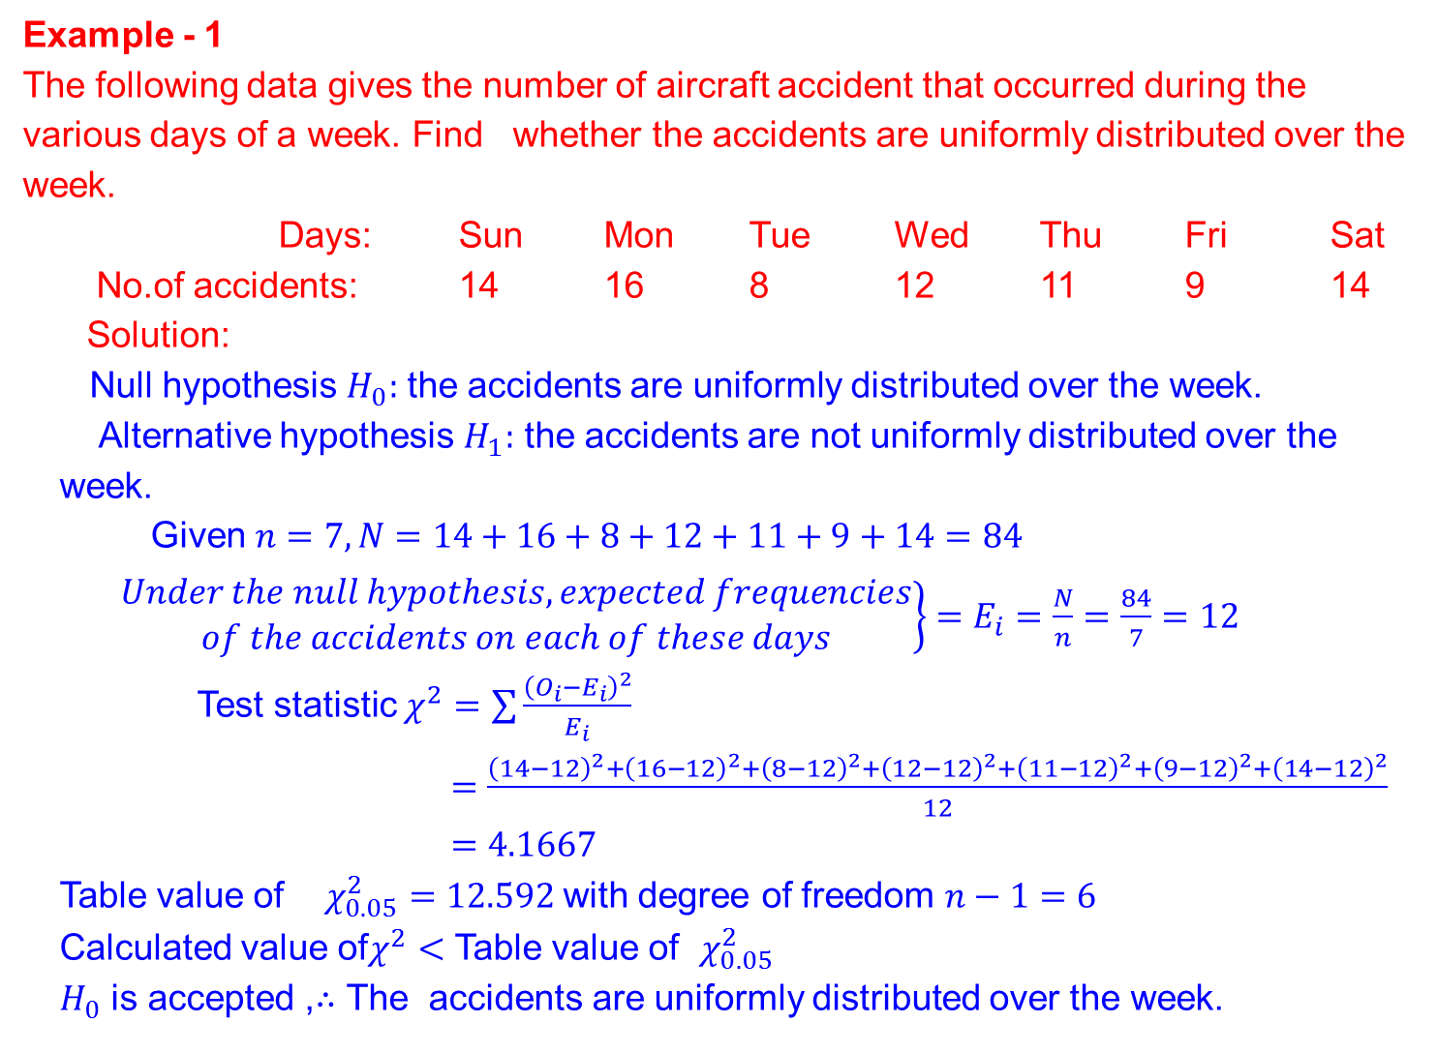
Example - 1
The following data gives the number of aircraft accident that occurred during the various days of a week. Find whether the accidents are uniformly distributed over the week.
Days: Sun Mon Tue Wed Thu Fri Sat
No.of accidents: 14 16 8 12 11 9 14
Solution:
Null hypothesis $H_{0}:$ the accidents are uniformly distributed over the week.
Alternative hypothesis $H_{1}:$ the accidents are not uniformly distributed over the week.
Given $n=7,N=14+16+8+12+11+9+14=84$
$\left.\begin{aligned}Under the null hypothesis, expected frequencies \\ of the accidents on each of these days\end{aligned}\right\}=E_{i}=\frac{N}{n}=\frac{84}{7}=12$
Test statistic $χ^{2}=\sum{\frac{{\left(O_{i}−E_{i}\right)}^{2}}{E_{i}}}$
$=\frac{{\left(14−12\right)}^{2}+{\left(16−12\right)}^{2}+{\left(8−12\right)}^{2}+{\left(12−12\right)}^{2}+{\left(11−12\right)}^{2}+{\left(9−12\right)}^{2}+{\left(14−12\right)}^{2}}{12}$
$=4.1667$
Table value of $χ_{0.05}^{2}=12.592$ with degree of freedom $n−1=6$
Calculated value of$χ^{2}$ $<$ Table value of $χ_{0.05}^{2}$
$H_{0}$ is accepted ,$∴$ The accidents are uniformly distributed over the week.

Slide 46
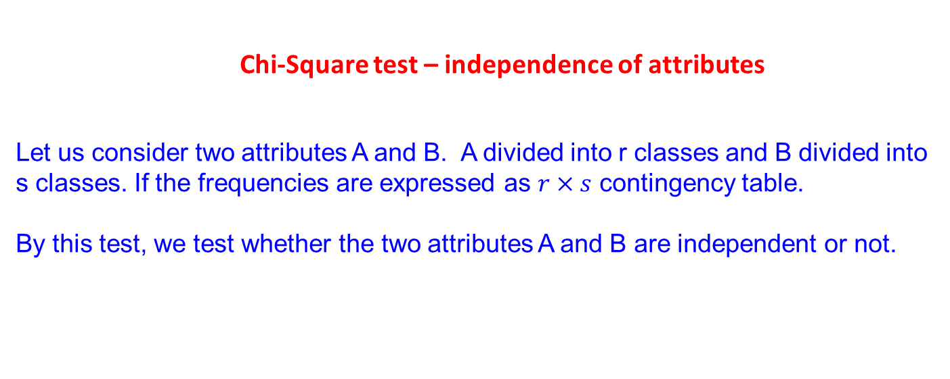
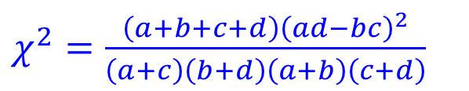
Chi-Square test – independence of attributes
Let us consider two attributes A and B. A divided into r classes and B divided into s classes. If the frequencies are expressed as $r×s$ contingency table.
By this test, we test whether the two attributes A and B are independent or not.
Formula for $χ^{2}$-test of independence for $2×2$ contingency table
a | b
c | d
$χ^{2}=\frac{\left(a+b+c+d\right){\left(ad−bc\right)}^{2}}{\left(a+c\right)\left(b+d\right)\left(a+b\right)\left(c+d\right)}$

Slide 47
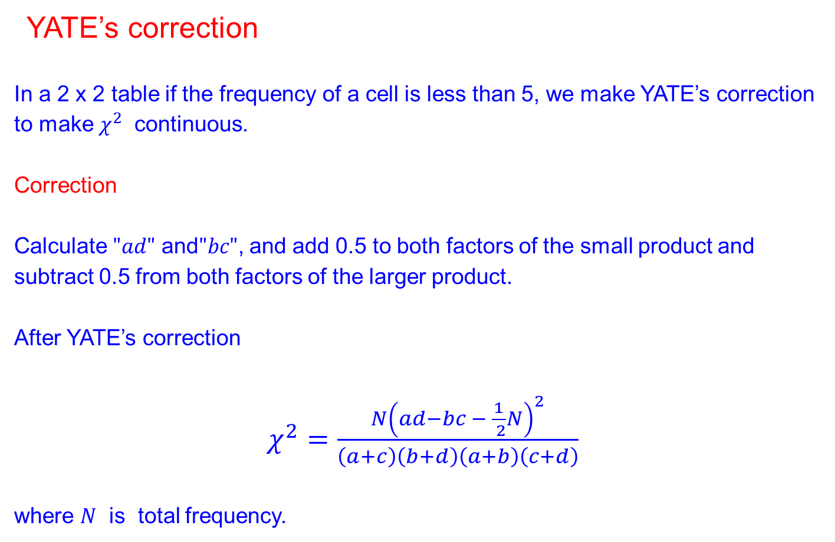
YATE’s correction
In a 2 x 2 table if the frequency of a cell is less than 5, we make YATE’s correction to make $χ^{2}$ continuous.
Correction
Calculate $"ad"$ and$"bc"$, and add 0.5 to both factors of the small product and subtract 0.5 from both factors of the larger product.
After YATE’s correction
$χ^{2}=\frac{N{\left(ad−bc − \frac{1}{ 2}N\right)}^{2}}{\left(a+c\right)\left(b+d\right)\left(a+b\right)\left(c+d\right)}$
where $N$ is total frequency.

Slide 48
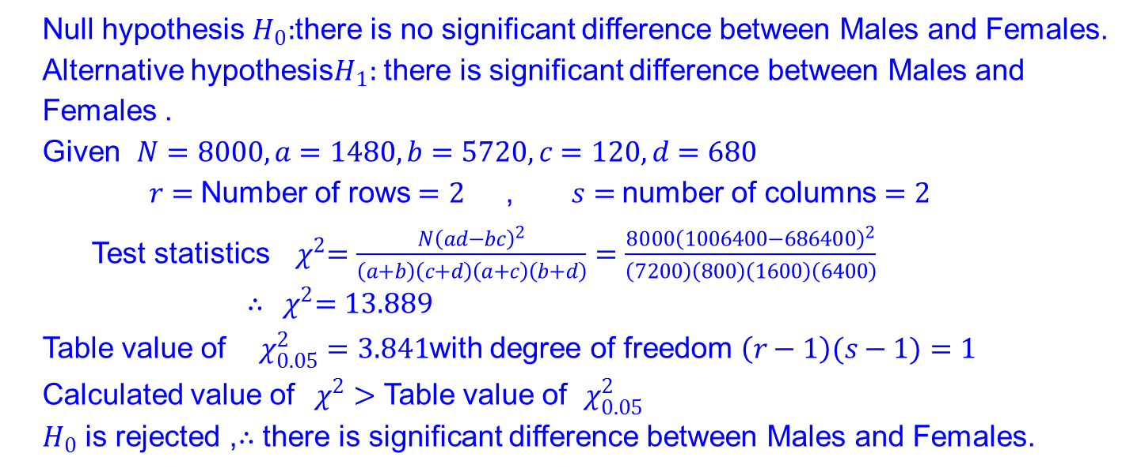
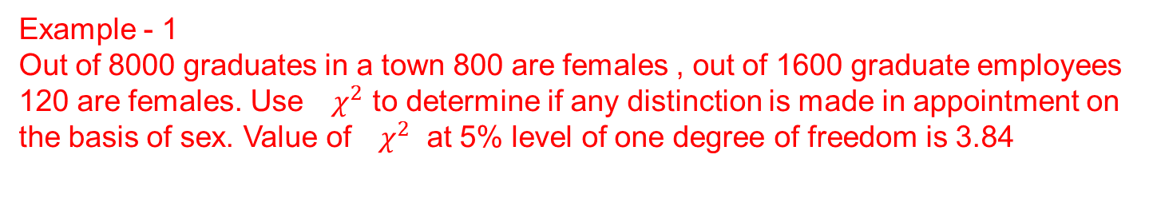
Example - 1
Out of 8000 graduates in a town 800 are females , out of 1600 graduate employees 120 are females. Use ${ χ}^{2}$ to determine if any distinction is made in appointment on the basis of sex. Value of ${ χ}^{2}$ at 5% level of one degree of freedom is 3.84
Solution The given information can be given in a tabular form.
 | Employment | Unemployment | Total
Males | 1480 | 5720 | 7200
Females | 120 | 680 | 800
Total | 1600 | 6400 | 8000
Null hypothesis $H_{0}:$there is no significant difference between Males and Females.
Alternative hypothesis$H_{1}:$ there is significant difference between Males and Females .
Given $N=8000,a=1480,b=5720,c=120,d=680$
$r=$Number of rows$=2$ , $s=$number of columns$=2$
Test statistics ${ χ}^{2}=\frac{N{\left(ad−bc\right)}^{2}}{\left(a+b\right)\left(c+d\right)\left(a+c\right)\left(b+d\right)}$ $=\frac{8000{\left(1006400−686400\right)}^{2}}{\left(7200\right)\left(800\right)\left(1600\right)\left(6400\right)}$
$∴{ χ}^{2}=13.889$
Table value of $χ_{0.05}^{2}=3.841$with degree of freedom $\left(r−1\right)(s−1)=1$
Calculated value of${ χ}^{2}$ $>$ Table value of $χ_{0.05}^{2}$
$H_{0}$ is rejected ,$∴$ there is significant difference between Males and Females.

Slide 49
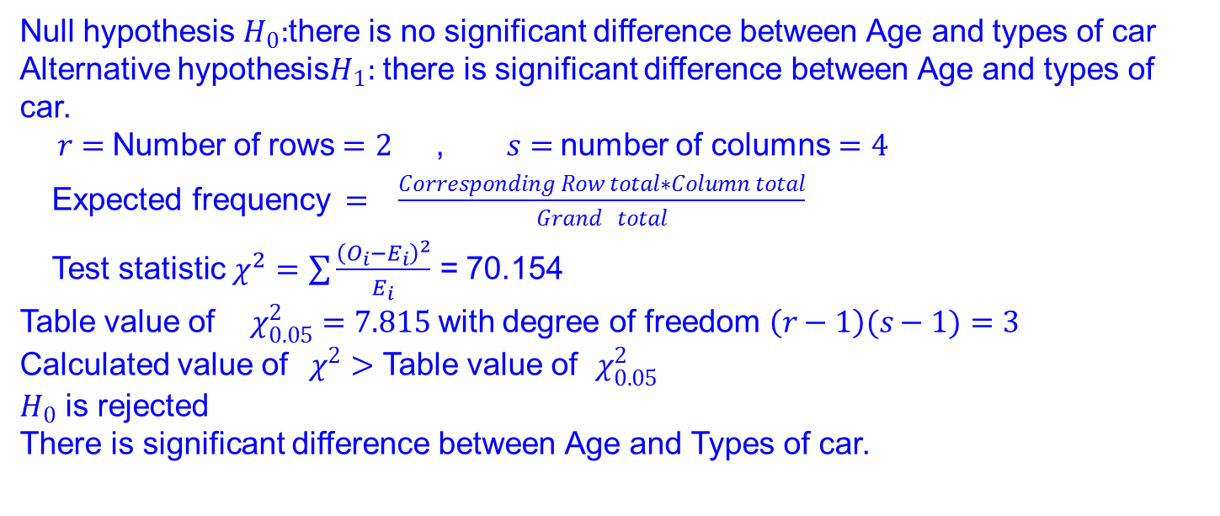
Example - 2
An automobile company gives you the following information about age groups and the linking for particular model of car which it planes to introduce .On the basis of this data can it be concluded that the model appeal is independent of the age group.
Persons who: | Below 20 | 20-39 | 40-59 | 60 and above
Liked the car | 140 | 80 | 40 | 20
Disliked the car | 60 | 50 | 30 | 80
Solution The given information can be given in a tabular form.
Null hypothesis $H_{0}:$there is no significant difference between Age and types of car
Alternative hypothesis$H_{1}:$ there is significant difference between Age and types of car.
$r=$Number of rows$=2$ , $s=$number of columns$=4$
Expected frequency$= \frac{Corresponding Row total∗Column total}{Grand total}$
Test statistic $χ^{2}=\sum{\frac{{\left(O_{i}−E_{i}\right)}^{2}}{E_{i}}}$ = 70.154
Table value of $χ_{0.05}^{2}=7.815$with degree of freedom $\left(r−1\right)(s−1)=3$
Calculated value of${ χ}^{2}$ $>$ Table value of $χ_{0.05}^{2}$
$H_{0}$ is rejected
There is significant difference between Age and Types of car.

Slide 50
REFERENCES
Johnson. R.A. and Gupta C.B, “Miller and Freund’s Probability and Statistics for Engineers”, 11th edition, Pearson Education, Asia, 2011.
Walpole R.E, Myers R.H., Myers S.L., and Ye.K “Probability and Statistics for Engineers and Scientists”, 8th edition, Pearson Education, Asia, 2007.
Spiegel M.R, Schiller J and Srinivasan R.A., “Schaum’s outlines on Probability and Statistics”, Tata McGraw Hill Eitin, 2004.

